Slide 1
An Overview of AI at VA
HealthTech Net Lunch Meet – Feb 2023
Rafael B. Fricks, Ph.D.
Associate Director for AI in Medical Imaging
National Artificial Intelligence Institute (NAII)
Massachusetts Veterans Epidemiology Research and Information Center (MAVERIC)
Department of Veterans Affairs

Slide 2
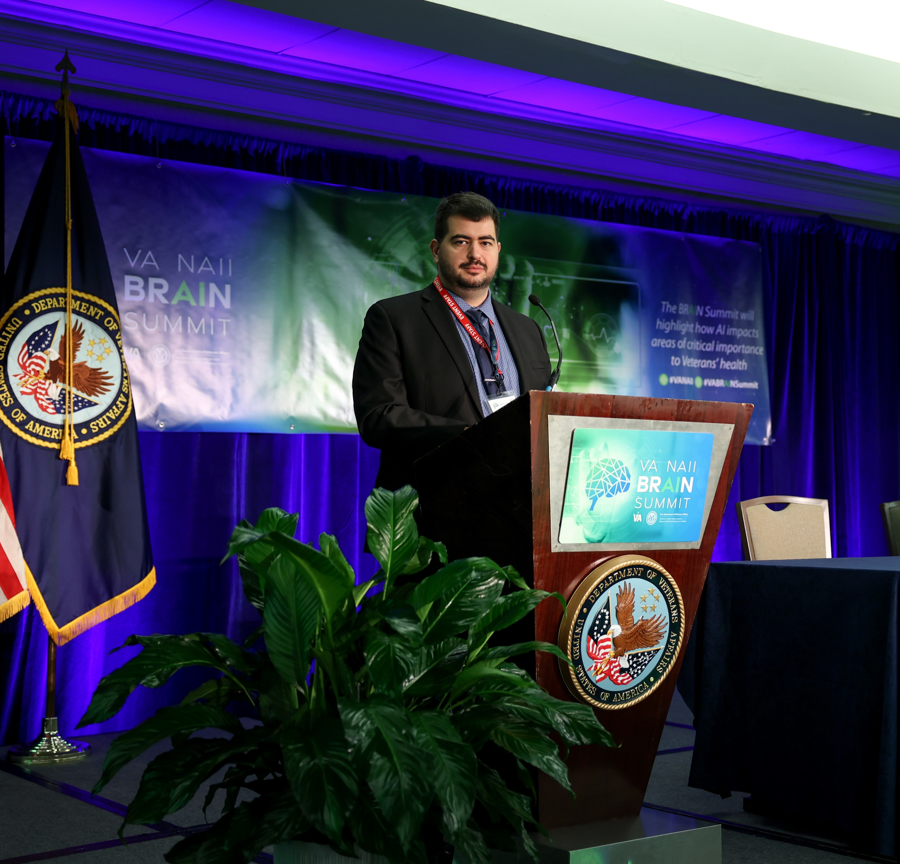
Speaker Bio
Rafael Fricks, PhD is the Associate Director for AI in Medical Imaging at the Department of Veterans Affairs National Artificial Intelligence Institute (NAII) and MAVERIC Center. He joined the VA in 2018 as a Big Data Science Training and Enhancement Program (BD-STEP) postdoctoral fellow, jointly as a visiting fellow with the Radiology Department at Duke University. He has refereed and published a number of peer-reviewed research papers in topics such as computer vision, artificial intelligence in radiology, safety, image quality, operations research, and probabilistic modeling for health care systems. He organizes the NAII AI Tech Sprint challenges on behalf of the VA, as well as the AI Summit Series. He received his BS in biomedical engineering from the University of Texas at Austin in 2013, and his MS and PhD in biomedical engineering at Duke University in 2017 and 2018, respectively.

Slide 3
Overview
Why AI at VA?
AI Tech Sprints
The Future
My Pathway
Getting Involved

Slide 4
Why AI at VA?

Slide 5
120,000 clinicians
9.1 million patients
The majority of U.S. doctors and nurses do at least some of their training at VA.
VA is the largest integrated healthcare system in the U.S.
Why AI at VA?
800,000 genomic donations
2.2 million telehealth episodes/year
More than 727,000 Veterans are served by telehealth/year.
VA has the largest genomic database tied to medical records in the world.
1,200+ medical facilities
10 billion medical images
Veterans receive care across all U.S. states and territories.
VA has one of the world’s largest medical image repositories.

Slide 6
VA AI Strategy
Set the VA’s vision and mission to improve outcomes and experiences for our Veterans by developing trustworthy AI capabilities.
VA is one of the first five federal agencies with an official and explicit AI strategy. Brought together 20+ offices across VA.
See it here: www.va.gov/guidance

Slide 7
VA’s AI Strategic Priorities
Build a robust community and network around Artificial Intelligence at the VA
Prioritize and invest in AI research
Reduce barriers to translating AI advances into real-world capabilities
Adopt an AI maturity model tailored to the VA’s mission and needs

Slide 8
National Artificial Intelligence Institute
Vision
To lead the way in trustworthy artificial intelligence as a premier global institute for research, implementation, policy, and collaboration that enhances outcomes for our Veterans, their families, and beyond.
Mission
The National Artificial Intelligence Institute seeks to establish the U.S. Department of Veterans Affairs as the preeminent organization for research, development, and training of artificial intelligence with impact on a global scale, ensuring the health and well-being of our Veterans.

Slide 9
What does the NAII do at VA?
Identify and Pilot New AI Technologies
Inform and guide VA policies around AI
Provide AI Subject Matter Expertise

Slide 10
Groundwork: Guiding Documents
Executive Orders 13859 and 13960
Maintaining American Leadership in Artificial Intelligence
Promoting the Use of Trustworthy Artificial Intelligence in the Federal Government
Strategies
National AI R&D Strategy (2019)
VA AI Strategy, VA/DOD Strategies
2021 National Defense Authorization Act (NDAA)
NDAA Fiscal Year 2021 called for a National AI Initiative to coordinate AI research and policy across the federal government.
AI Bill of Rights
Released in October 2022, the AI Bill of Rights presents five pillars to guide the design, development and deployment of AI and automated systems so they protect the rights of the American public.

Slide 11
Choosing Our AI Work
Medical
Centers
Veteran Input
AI@VA Community
Advisory Board
Feasibility
AI Task Force
NAII
Focus Areas

Slide 12
Community
Over 500 unique VA employee members and over 300 industry, government, and academia mailing list members
AI@VA Community SharePoint and MS Teams group for VA employee members
SME led interest groups with curated content and resources
Current AI news and research, updated daily
Learning Resource Hub with new resources added regularly
Monthly Lunch and Learn series with leading SMEs
Messaging reach of over 25k+ VA employees

Slide 13
Building the AI Network
Across VA medical/centers, with academic affiliates, and external partners
Developing network and governance structures in collaboration with Data Governance Council
Subgroups with particular specialty areas and emphasis
Precision Oncology, Computer Vision, Diagnostic AI, Trustworthy AI, AI Ethics, Use Case Development
R&D with eye toward piloting

Slide 14
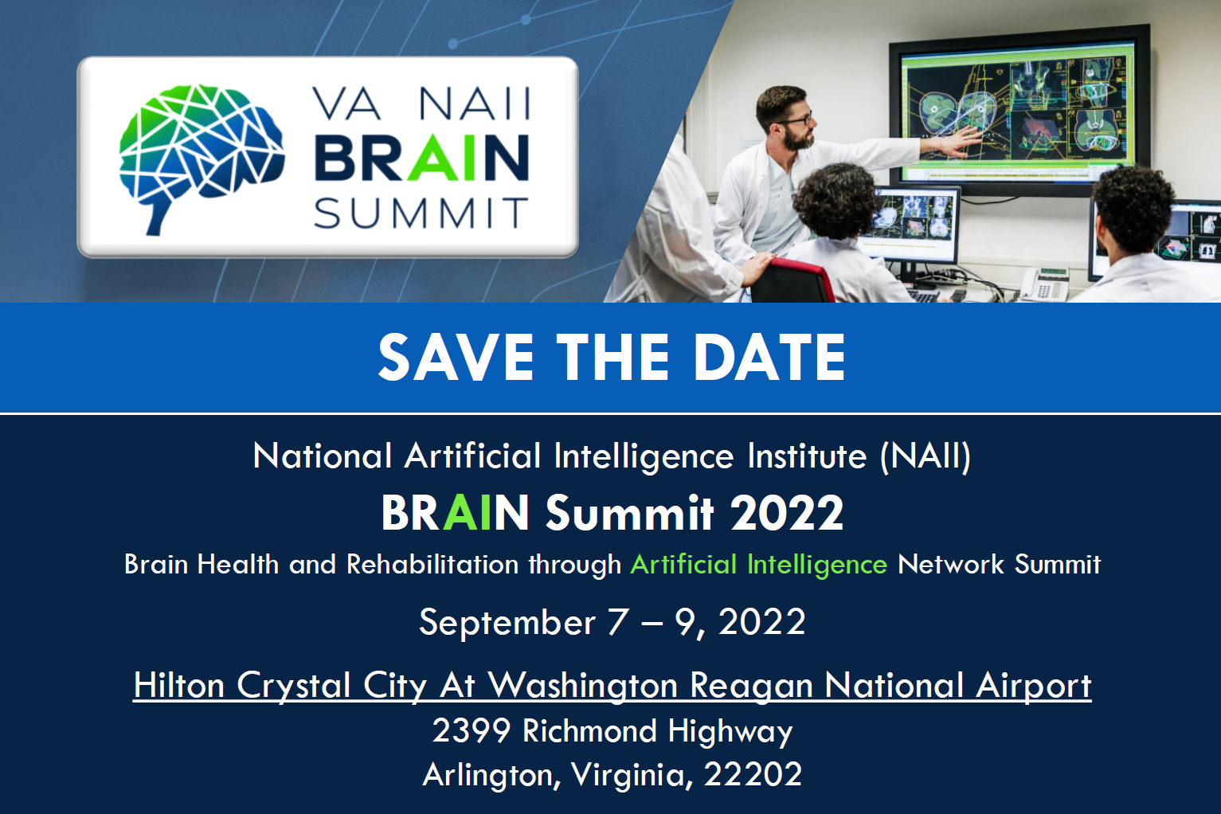

Slide 15
AI Tech Sprints

Slide 16
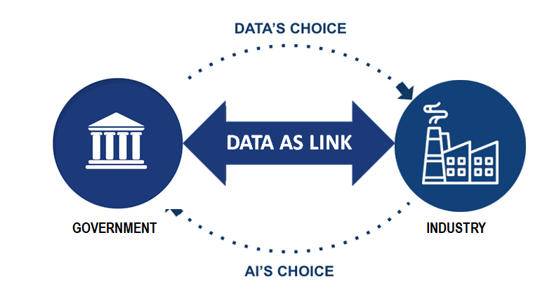
The AI Tech Sprint
We use data as a bidirectional link between government and users of that data across industry, government labs, and others.
Large, unique data sources (on clinical trials, patents, experimental therapeutics, patients)
Veteran and Expert perspectives
Technical expertise and user-based feedback
Demo and funding opportunities
Innovative product ideas
Technical AI/ML expertise
Trusted AI solution development through collaboration
Product development expertise
https://www.research.va.gov/naii/tech-sprints.cfm

Slide 17
AI Tech Sprint Roadmap
0: Creating the Future of Health Care
1: Veterans Not Currently Served by VA
2: ASPIRE Demonstrator
3: Imaging Sprint
4 and Beyond
Coincided with the founding of the VA NAII
Lead to various pilot projects within the VA
Create a demonstrator for the ASPIRE program
Currently in development for Q2 2023
AITS to be offered annually

Slide 18
AI Tech Sprint Roadmap
0: Creating the Future of Health Care
1: Veterans Not Currently Served by VA
2: ASPIRE Demonstrator
3: Imaging Sprint
4 and Beyond
Coincided with the founding of the VA NAII
Lead to various pilot projects within the VA
Create a demonstrator for the ASPIRE program
Currently in development for Q2 2023
AITS to be offered annually

Slide 19
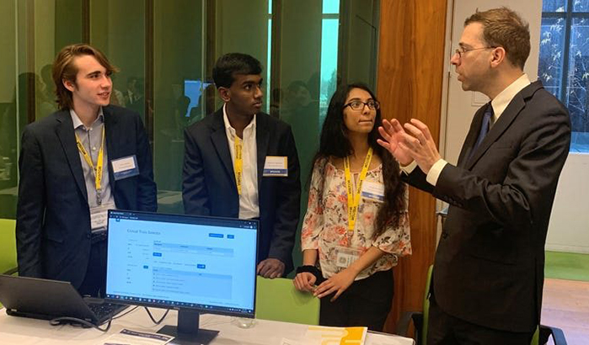
AI Tech Sprint 0
In August 2019, the VA Lighthouse team launched its minimum viable product API
To capitalize on this launch, a first tech sprint invited teams to produce AI tools that used this API and could improve clinical trials
Teams were local to the DC area
Program was successful
Teams recognized at The Opportunity Project Demo Day, Nov 2019
Two projects underway at VA

Slide 20
Tech Sprint 1 Overview
CONCEPT
PARTNERSHIP
ACCESS TO DATA
RESULTS
Invite teams to produce AI tools to benefit “Veterans not currently served by VA”
Pair each team with a subject matter expert: VA clinicians and staff to guide development
Teams combine private data sources with VA data and expertise to create an AI-enabled tool
Proposals for potential pilot, development or contract with VA

Slide 21
AI Tech Sprint 1 Timeline An Iterative Approach
Preparation:
Oct. – Dec. 2020
Ideation:
January 2021
Refinement:
February 2021
Evaluation:
Mar. – Apr. 2021
Regulatory compliance
Conduct info sessions
Screen team applications
Teams prepared short ‘pitches’
Work to pair teams with SMEs
Written Milestone
Work with NAII to refine concepts
Variety of info meetings on tools and public data
Phase 2 Demos in video format
Targeted feedback for each prototype
Final demo in video format
Prototypes evaluated by panels

Slide 22
Tech Sprint 1 Participation
60
Teams Applied
44
Teams Invited
32
Demos Completed
Teams
Collaboration
Evaluation
From industry, academia, and other non-governmental organizations
> 90% of teams paired with at least one VA subject matter expert (SME)
Each demo graded by a panel of two clinical and two NAII judges

Slide 23
NAII AI Tech Sprint: 2022-2023
Theme: All Services Personnel and Institutional Readiness Engine (ASPIRE) Project
Competing teams work to create a computer-adaptive skill assessment platform that will assess, educate and streamline federal government talent, advancing an agile government workforce skilled in AI, data science and cybersecurity.
Finalists will be announced on November 14, 2022!

Slide 24
Encoding A
Person A
Training Path A
Milestone 1

Slide 25
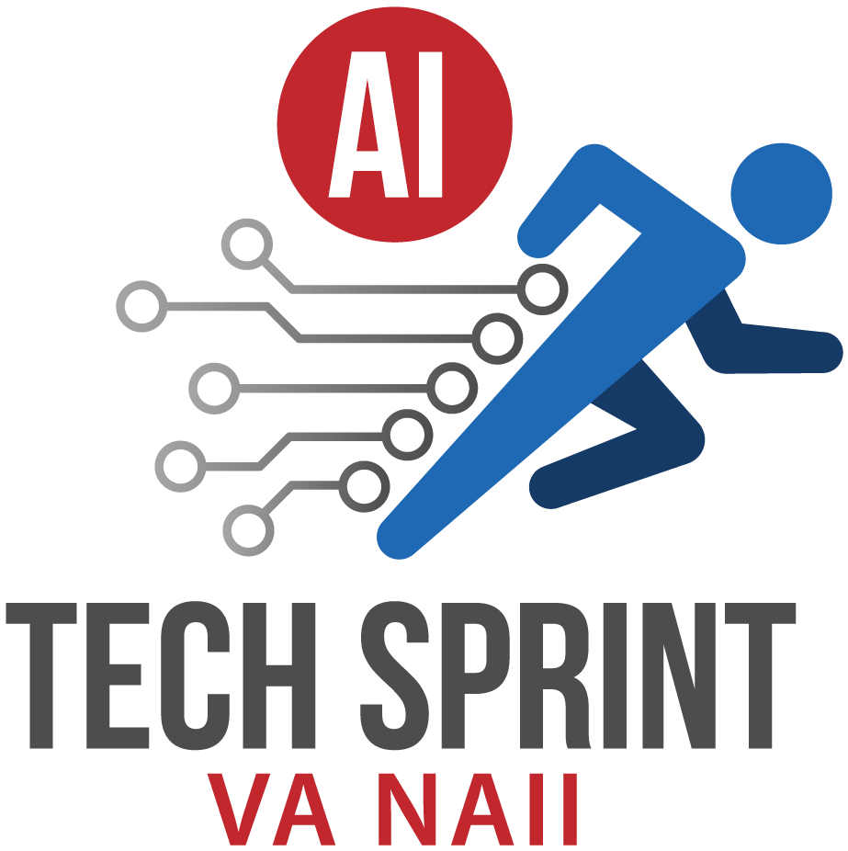
Scoring Criteria – Phase 1 (~6 weeks)
Scored by NAII Staff
Accurate Computerized Adaptive Assessment
Learning Management System
Quality of User Interface and Software Stability
Organization
Six finalists selected at the end of phase 1

Slide 26
0.20
Novice
0.50
Intermediate
0.90
Milestone 2
Expert

Slide 27
Scoring Criteria – Phase 2 (~6 weeks)
Two-part scoring
Scored by Panel of Senior VA Experts, same criteria as before
Beta Testing Accuracy Metrics
A total of $150,000 will be awarded to finalists based on standing

Slide 28
AI Pilots and Research

Slide 29
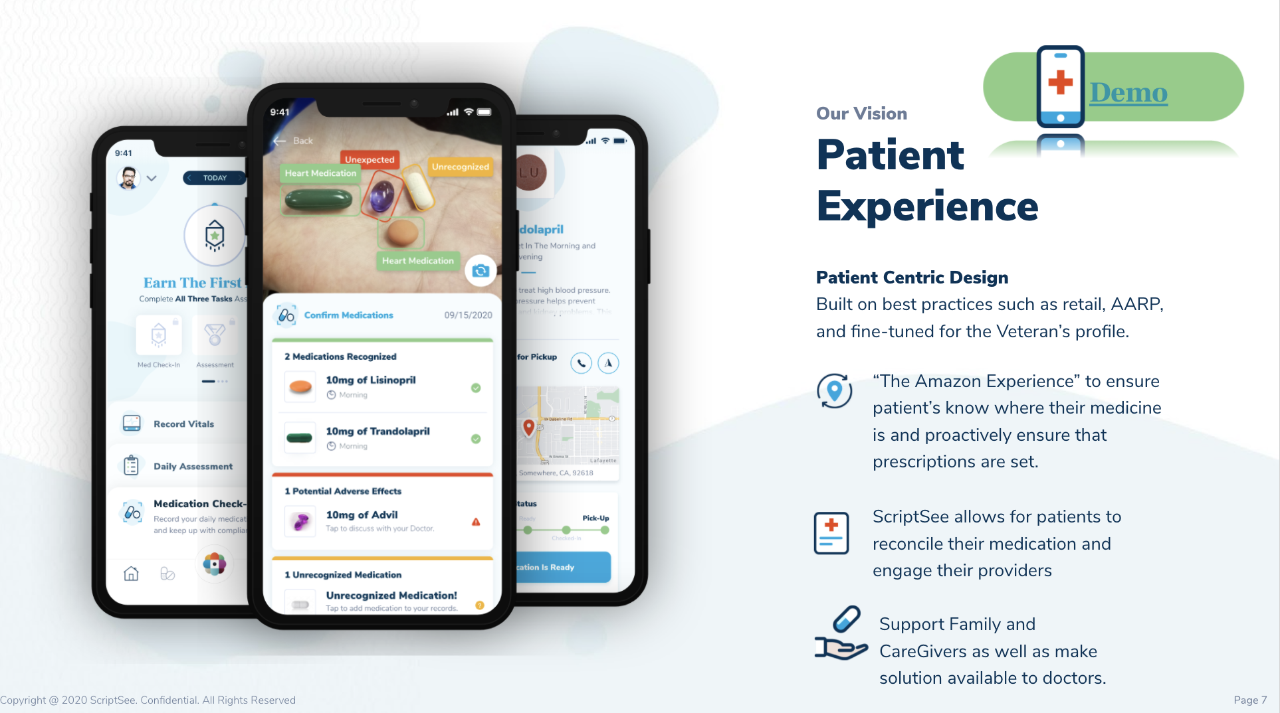
AI Tech Sprint Results: Medication Adherence (CuraPatient)
Leverages AI/machine vision to compare medication in image in hand versus in health record
FDA Drug API to National Drug Code data source of medication and adverse events, and compound composition:
VA Health API to access veterans’ data on medication, demographics, and immunization data sets:
Census data to improve health equity challenges with social economics, housing, and underserved communities.
Winner of “Future of Health” in national competition
Estimated average practitioner’s office could save approximately 4900 hours a year of phone calls.

Slide 31
Mental Health Monitor App
Runs in the background of a patient's phones and records patterns of usage. That is compared to a digital phenotype of an individual with diagnosed mental health disorders
Information can increase Veterans' awareness and lead to changes in treatment direction by the provider
1
2

Slide 32
AI Tech Sprint Results: Suicide Prevention System
VA operates a Veterans Crisis Line (VCL) available 24/7 to all veterans. Callers are sent a survey after each visit by the support team Vsignals.
Survey answers are plain text and screened by an antiquated rules-based system, resulting in over 90% false positive rate
The Suicidal Ideation Engine (SSIE) we are co-developing will apply natural language processing to improve message triage
This system was prototyped using publicly accessible texts using the HHS/VA Blue Button System API
We are piloting their prototype on a selection of VSignals messages in the Arches environment in VA Enterprise Cloud computing resources

Slide 33
Suicidal Ideation Detection
Timely identification of Veterans in crisis is imperative for lifesaving interventions.
The current rule-based filtering has resulted in a high false-positive rate, overwhelming the VA Veterans Crisis Line (VCL) and White House VA Hotline.
Implementing a natural language processing (NLP) engine will allow quicker, more accurate filtering of text responses, allowing the VCL and White House VA Hotline to identify and help Veterans in crisis quickly.

Slide 34
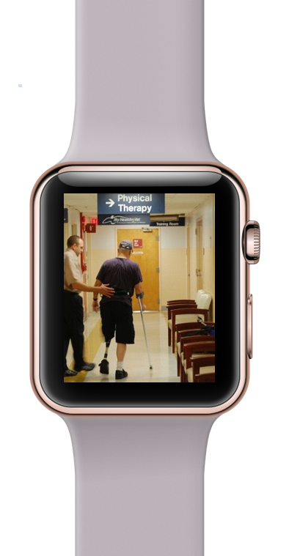
Physical Therapy App
1
Data source agnostic physical therapy explainable AI tool
2
Take data from variety of sources such as wearable technologies
Numerous applications including off site rehab protocol monitoring, gait monitoring, prediction of overuse injuries
3

Slide 35
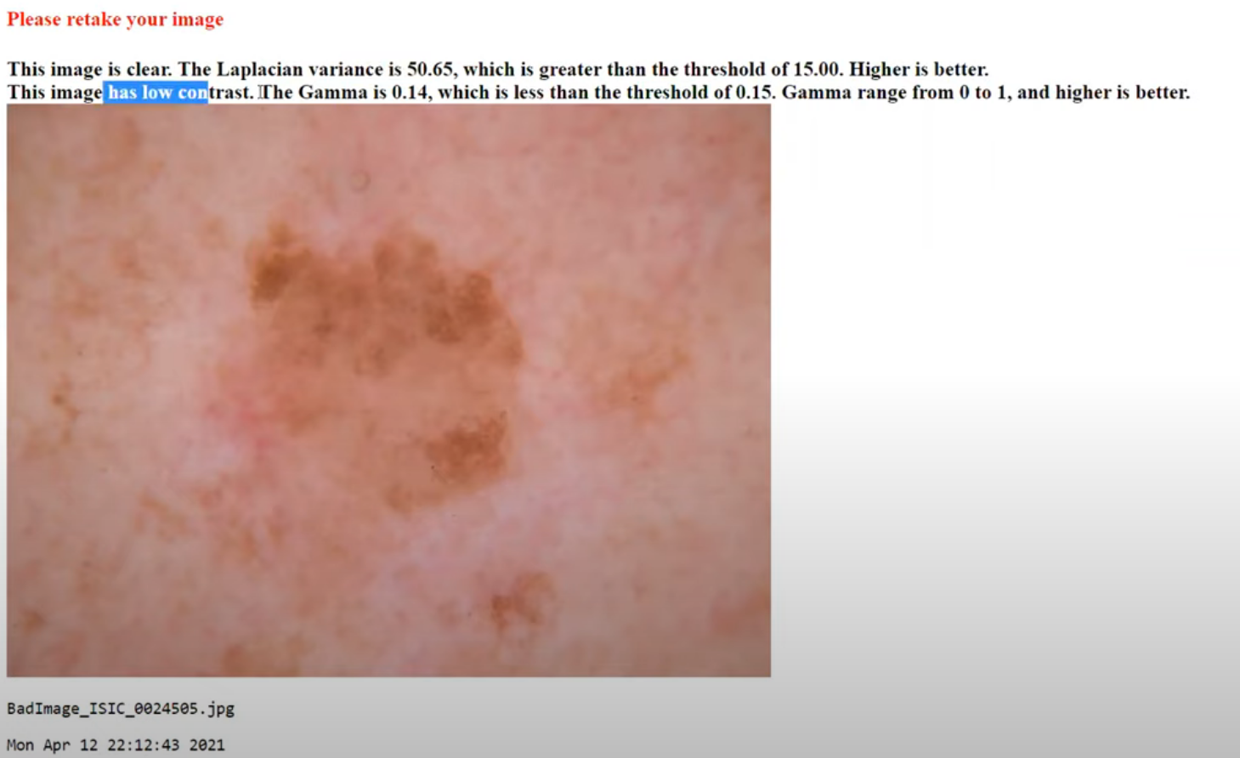
AI Tech Sprint Results: Computer Aided Diagnostics for Teledermatology
This prototype was developed by training a deep learning computer vision algorithm to distinguish between seven types of skin lesions
A public database of 10,029 skin lesion images were divided into a set of 8,018 for development and 2,011 for validation
The top performing method achieved a near perfect 0.94 AUC
This early prototype allows providers to drag and drop images for rapid analysis, including an assessment of the image quality
Providers get immediate feedback on low contrast, blurry, or otherwise unusable images, as well as a recommended diagnosis

Slide 36
The Future

Slide 37
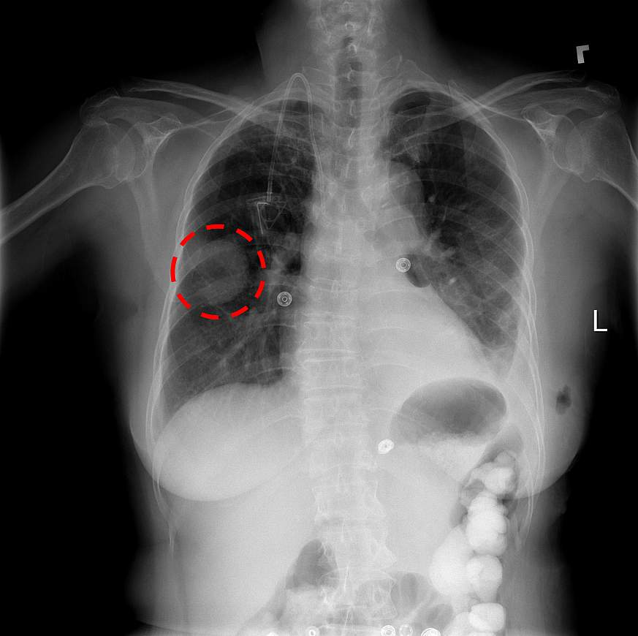
Courtesy Chestxray14 dataset, X. Wang et al, NIH

Slide 38
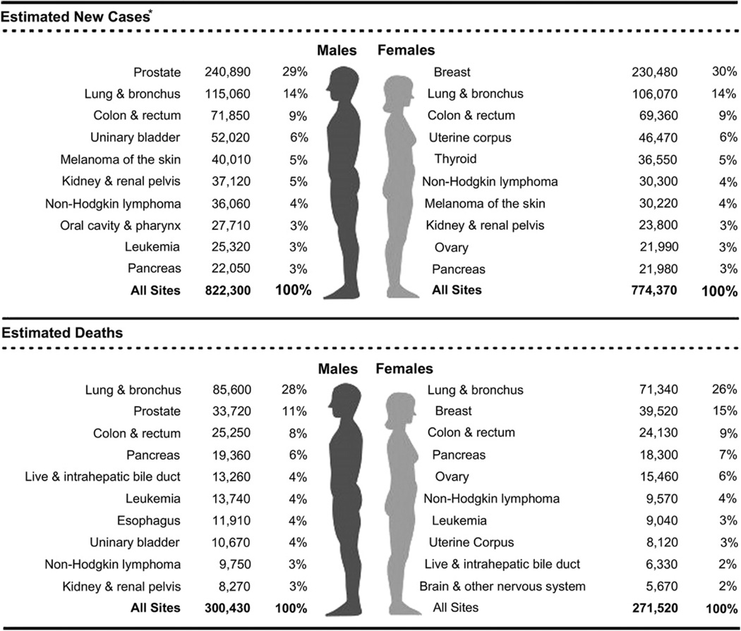
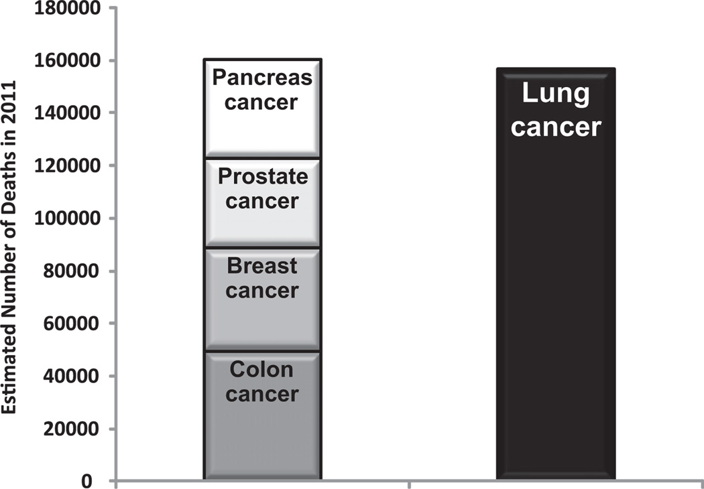
Why focus on lung cancer?

Slide 39
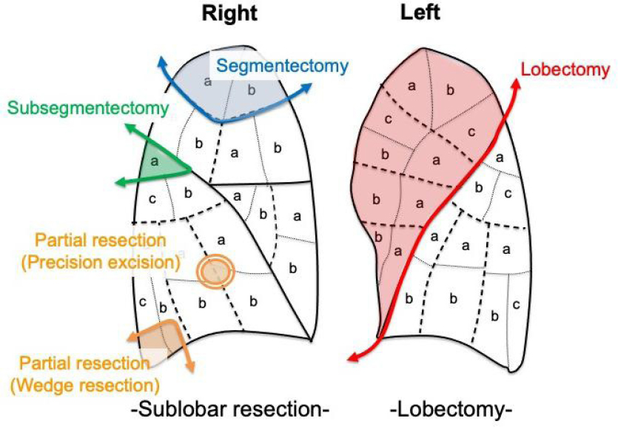
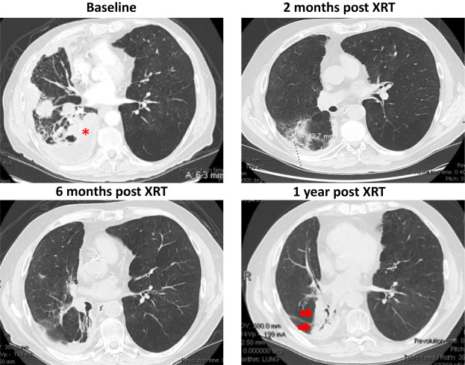
Four Questions
Can we improve screening?
Can we improve diagnosis?
Can we improve treatment?
How do we follow up?

Slide 40
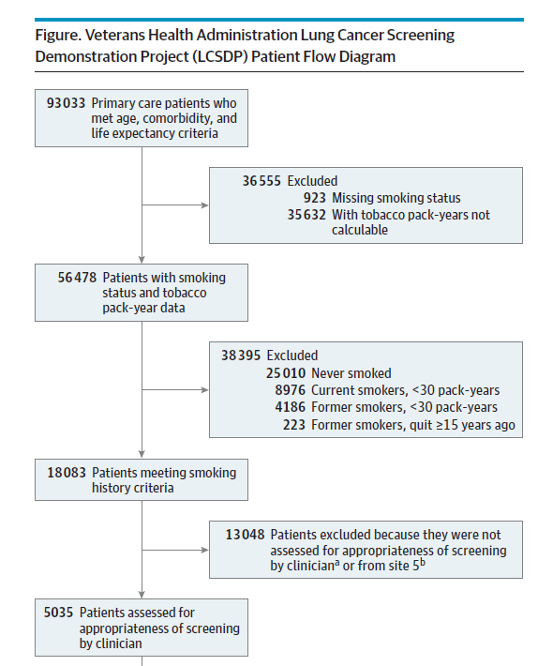
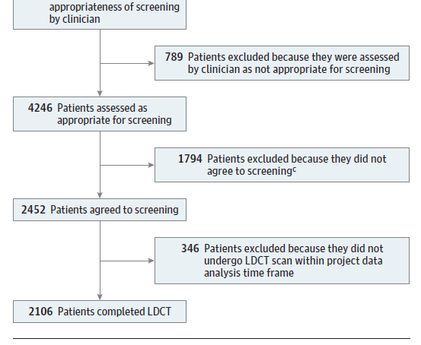
Existing VA Efforts
Lung Cancer Screening Demonstration Project (LCSDP):
Goal: Implement the recommendations of Non-Small Cell Lung Cancer Trials
8 Sites across VA, 3-year data collection time frame
Estimated 900,000 VA patients may be eligible
Only 58% agreed to screening
Lung cancer screening guidelines:
May improve lifespan for eligible patients by ~1 year
Inclusion criteria:
Age 50-80, in ‘fairly good health’
Currently smoke or have quit in the last 15 years
Must have a 20 pack-year smoking history (used to be 30)
Must be enrolled in smoking cessation program
Informed decision between patient and doctor
Not available at all centers

Slide 41
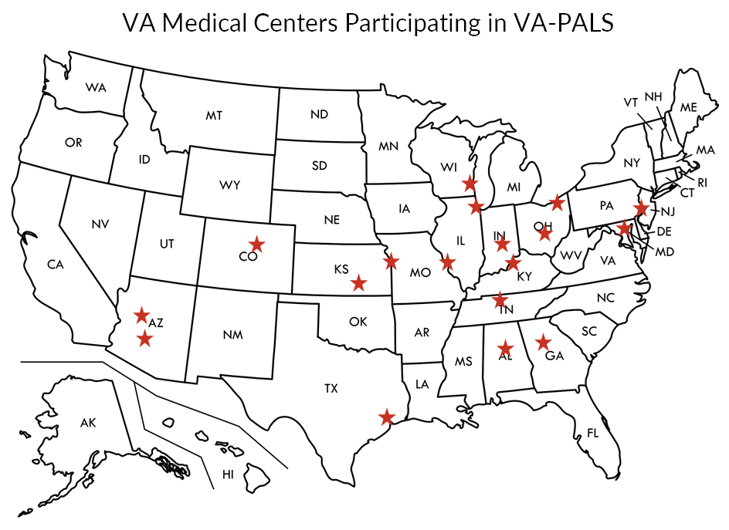
Existing VA Efforts
VA Partnership to increase Access to Lung Screening (VA-PALS):
Goal: Improve capacity for screening at VA
“The project was launched in 2017 after an earlier clinical demonstration project identified substantial variability and challenges with efforts to implement new lung cancer screening programs in the VA.”
Partnership with International Early Lung Cancer Action Program (I-ELCAP)
Launched in 2017 based on results from LCSDP
Three proposed directions for this project:
Large-scale examination of LDCT images with artificial intelligence and machine learning techniques
Epidemiologic investigations of environmental and genetic risk factors to better understand the high percentage of veterans diagnosed with lung cancer who were never smokers or had quit many years ago
Multisite clinical trials that explore early detection blood screening tests that are under development.

Slide 42
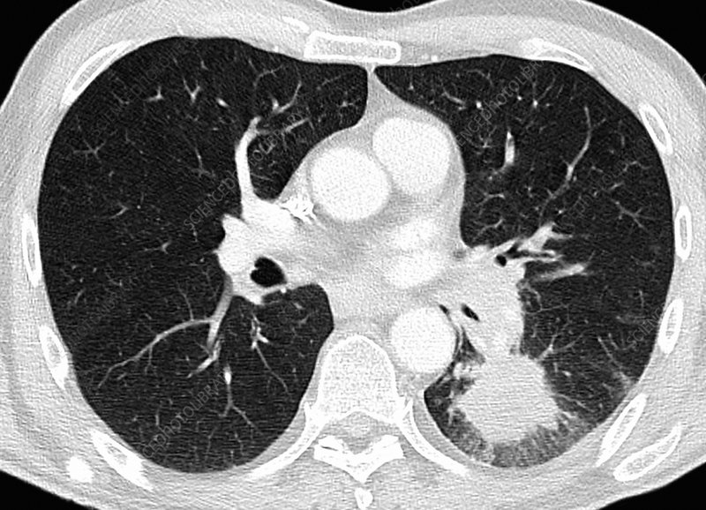
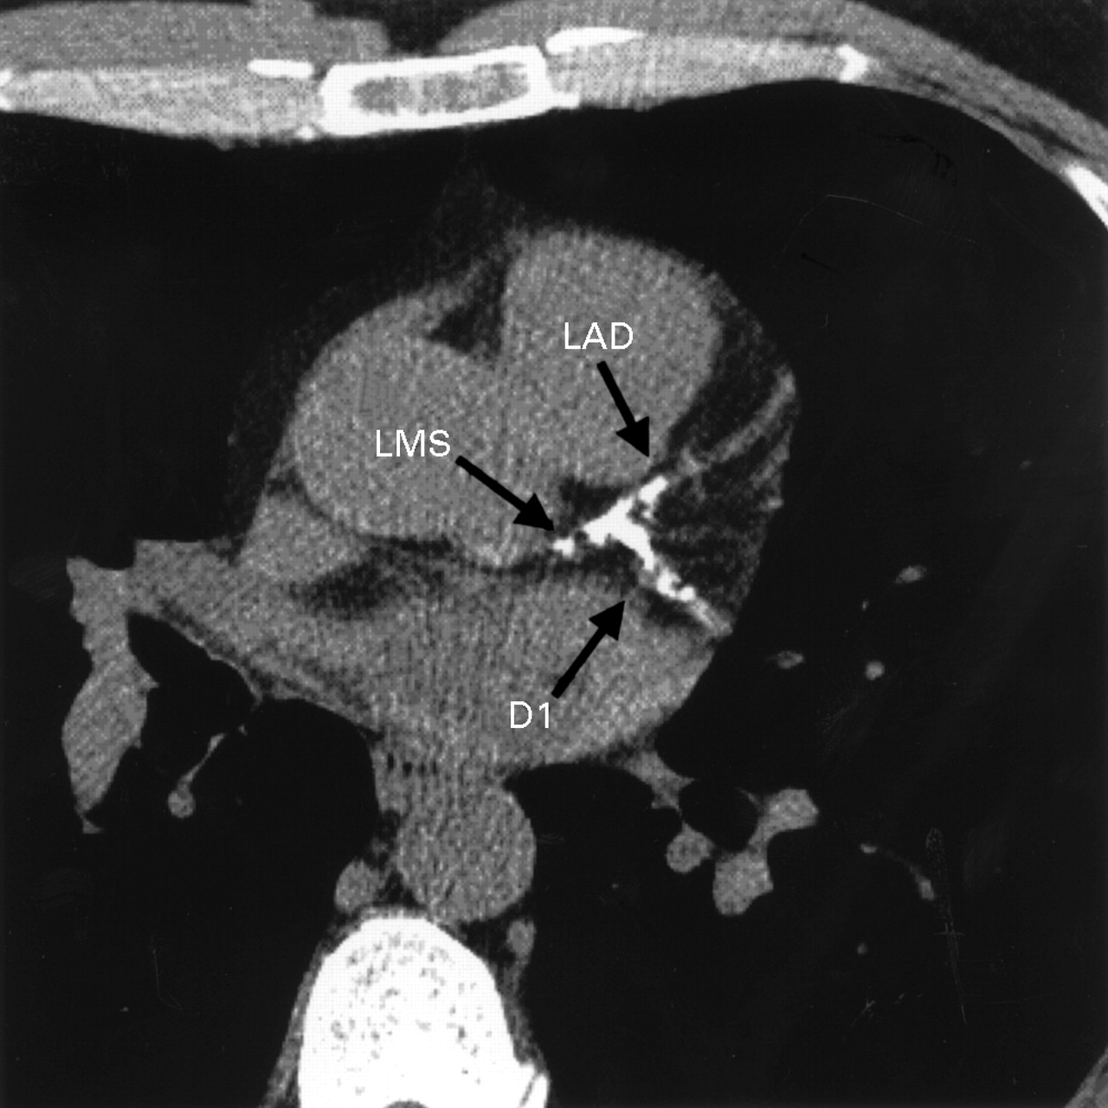

Slide 43
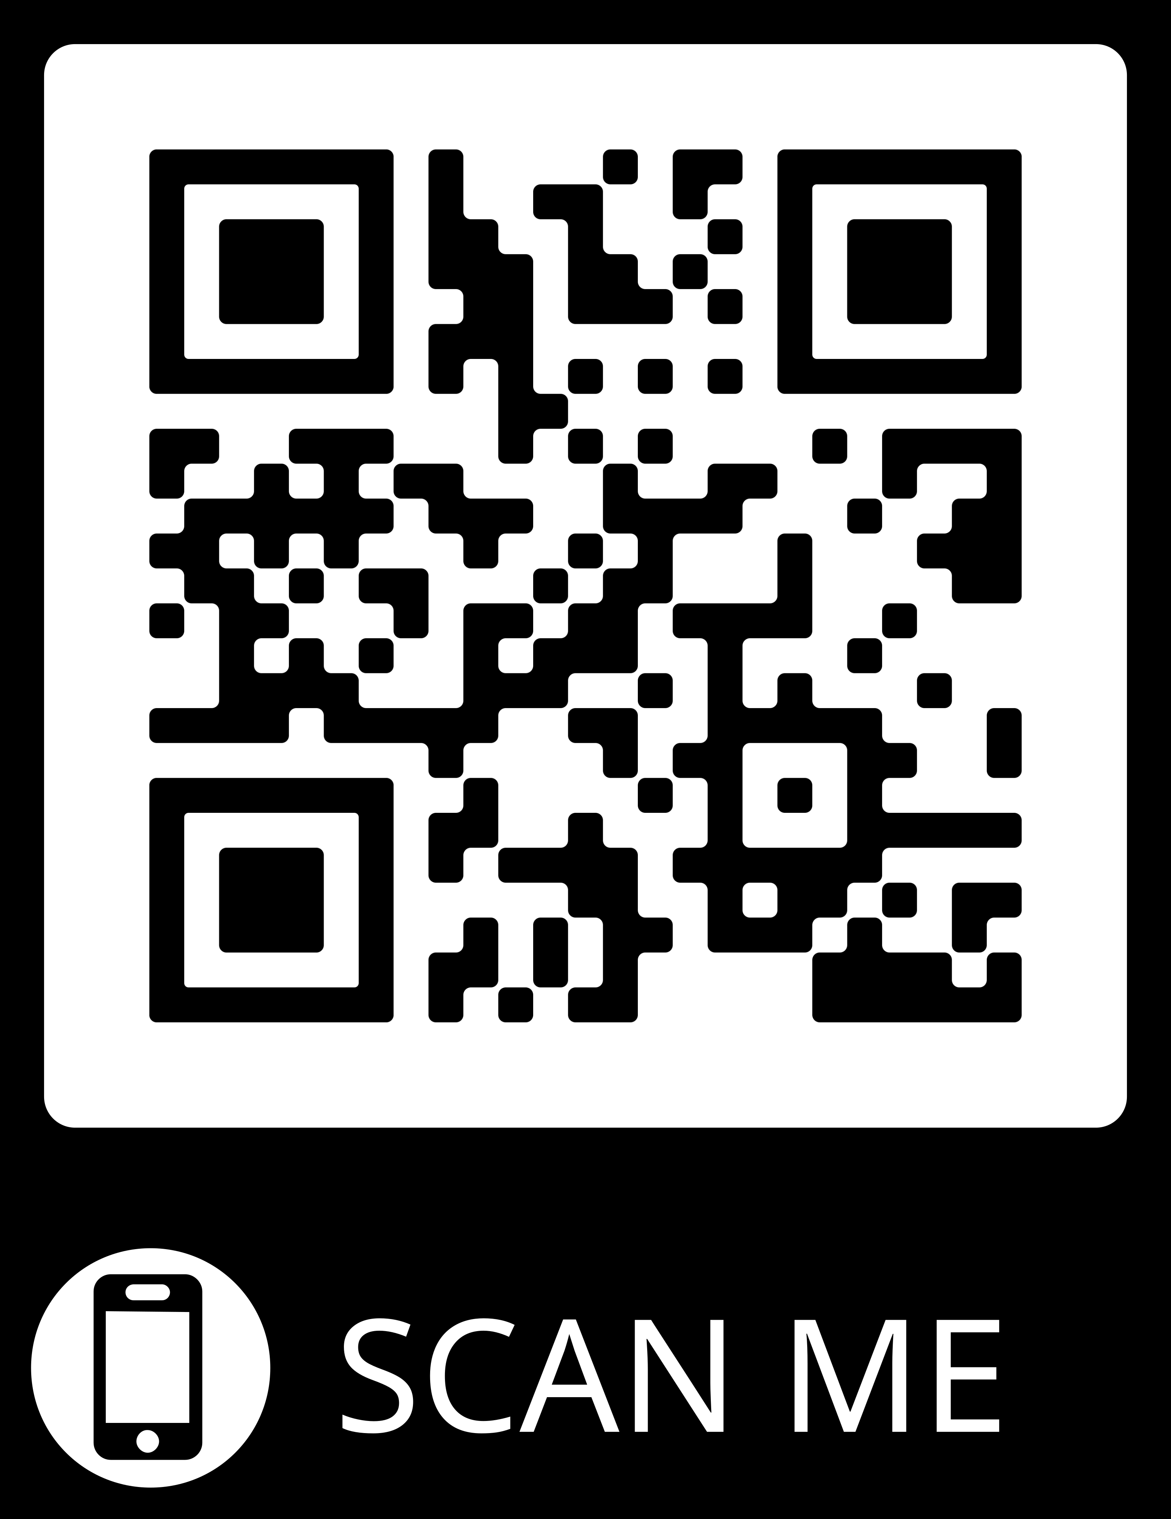
​Email us at naii@va.gov
Website: National Artificial Intelligence Institute (NAII) (va.gov)
Join the AI@VA Community:
AI@VA Community SharePoint: AI@VA - Community Home (sharepoint.com)
AI@VA Community on Teams: https://tinyurl.com/VA-AI-Community
Subscribe to our newsletter: Join the AI@VA Community

Slide 44
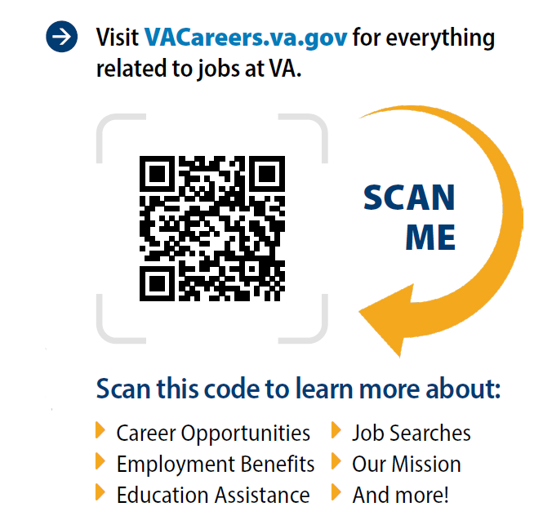

Slide 45
Questions?

Slide 46
Appendix

